Slide 1
Chapter 3
Types of Business Ownership

Slide 2
Types of Business Ownership
Chapter
3
public sector
private sector
competition
price competition
nonprice competition
market
oligopoly
monopoly
profit
sole proprietorship
entrepreneur
Employer Identification Number (EIN)
unlimited liability
limited life
partnership
partnership agreement
general partner
limited partner
cooperative
corporation
articles of incorporation

Slide 3
Types of Business Ownership
Chapter
3
corporate bylaws
corporate charter
board of directors
limited liability company (LLC)
franchise

Slide 4
Freedom to Compete
Types of Business Ownership
Chapter
3
Price Competition – price is the biggest factor , consumers will choose the lowest price
Non-price Competition – factors other than price attract and keep customers

Slide 5
Levels of Competition
Types of Business Ownership
Chapter
3
Oligopoly– a few large businesses in the market and many customers who need the product
Monopoly– only one supplier in the market, no competition

Slide 6
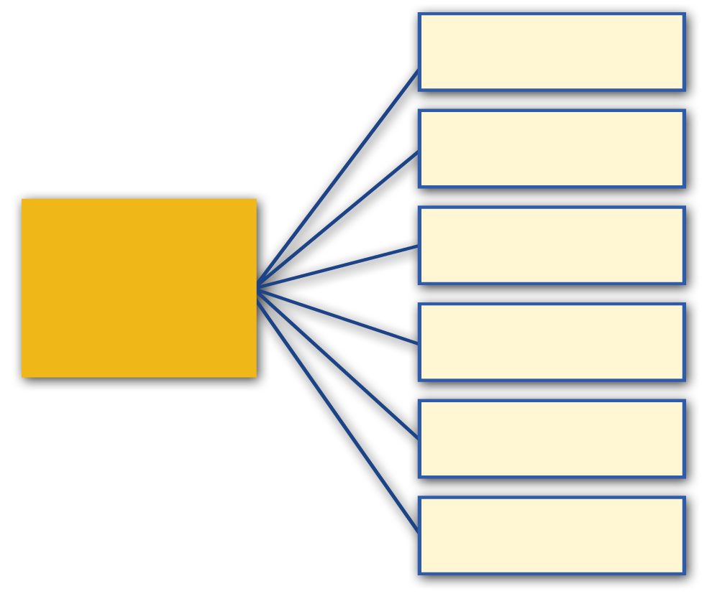
Private Enterprise System
Types of Business Ownership
Chapter
3
Competition
Economic Changes
Profit made from Doing Business
Risks of Doing Business
Government Regulations
Vs.
New Technologies
Natural Disasters
Lawsuits

Slide 7
Business Ownership Organization
Types of Business Ownership
Chapter
3
Three Legal Forms of Business Ownership
Sole Proprietorship
Partnership
Corporation

Slide 8
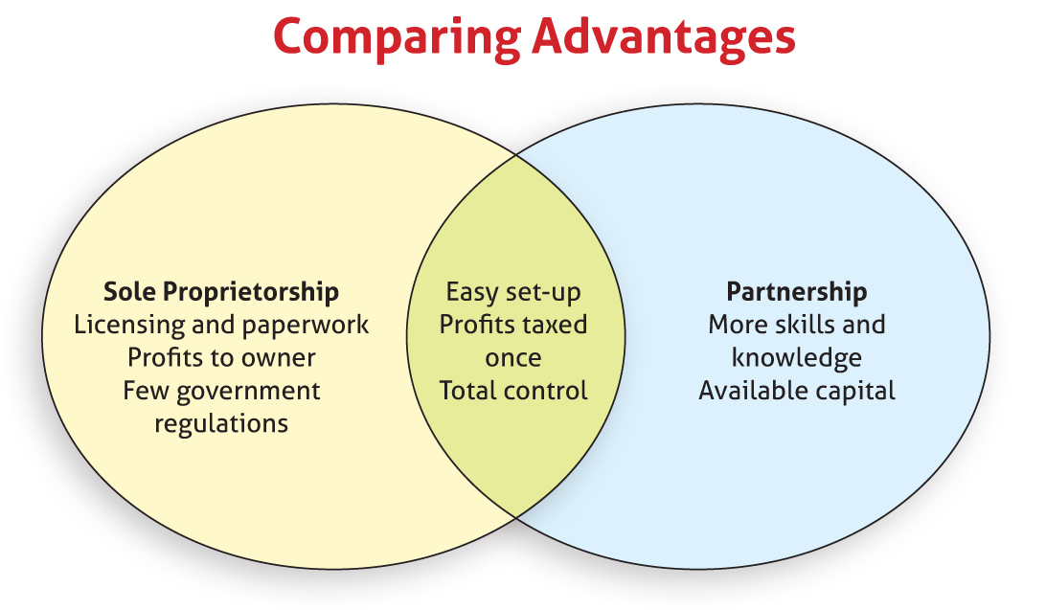
Sole Proprietorship vs Partnership
Types of Business Ownership
Chapter
3

Slide 9
Starting a Corporation
Types of Business Ownership
Chapter
3
Shares of stock in a corporation are bought by people who become known as stockholders.

Slide 10
Starting a Corporation
Types of Business Ownership
Chapter
3
Two Types of Corporations
Closely Held Corporation
Publicly Held Corporation

Slide 11
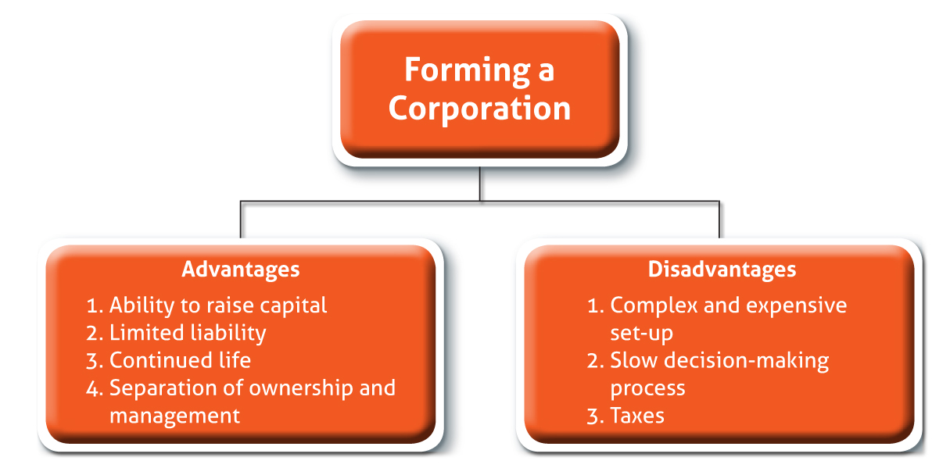
Starting a Corporation
Types of Business Ownership
Chapter
3

Slide 12
Types of Business Ownership
Chapter
3
Economic Systems
Government makes the economic decisions of
Command Economy
What to produce
How it should be produced
For whom it should be produced
Market Economy
The three economic decisions are made in the marketplace.

Slide 13
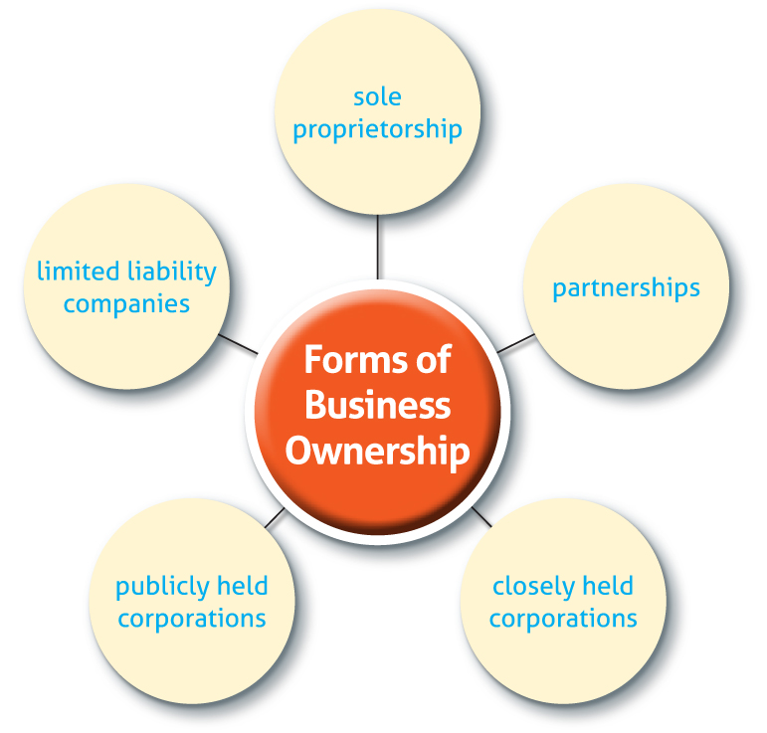
Types of Business Ownership
Chapter
3
franchise

