Slide 1
Business Math
Chapter 2
The Economics and the Global Economy

Slide 2
Economics and the Global Economy
Chapter
2
fiat money
money supply
budget deficit
budget surplus
patent
copyright
trademark
Gross Domestic Product (GDP)
Consumer Price Index (CPI)
inflation
deflation
recession
trough
specialization
international trade
absolute advantage
comparative advantage
balance of trade
protectionism

Slide 3
Economics and the Global Economy
Chapter
2
tariff
quota
embargo

Slide 4
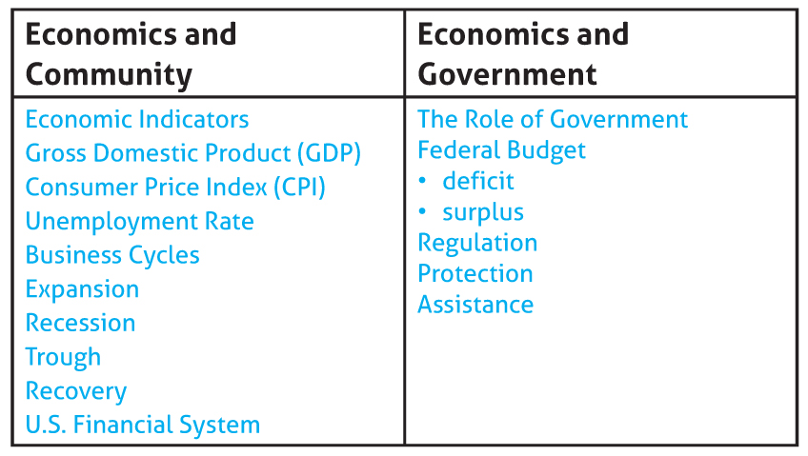
Economics and the Global Economy
Chapter
2

Slide 5
Role of Money
Economics and the Global Economy
Chapter
2
Section 1
The U.S. uses fiat money. This means the government has deemed it to be money or legal tender.
Trading
Saving
What Is Money Used for?
Lending
Investing

Slide 6
Functions of Money
Economics and the Global Economy
Chapter
2
Section 1
Medium of Exchange
Unit of Value
Store of Value

Slide 7
Properties of Money
Economics and the Global Economy
Chapter
2
Section 1
Usable
Stable
Divisible

Slide 8
Properties of Money
Economics and the Global Economy
Chapter
2
Section 1

Slide 9
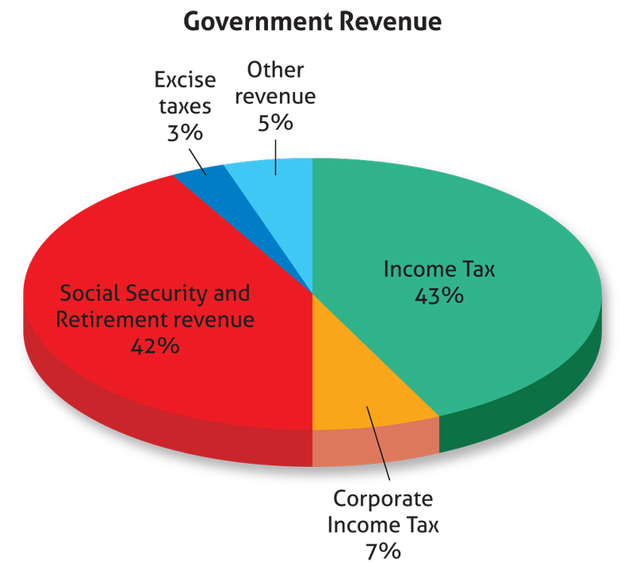
Role of Government in the Economy
Economics and the Global Economy
Chapter
2

Slide 10
Role of Government in the Economy
Economics and the Global Economy
Chapter
2
Regulation
Security and Exchange Commission (SEC) regulates stocks and bonds
Federal Reserve System (The Fed) regulates the U.S. banking system and monetary policy
Occupational Safety and Health Administration (OSHA) issues guidelines for worker safety
Equal Employment Opportunity Commission (EEOC) regulates hiring, firing, and promotions to ensure equal treatment based on ability
Food and Drug Administration (FDA) regulates food safety and labeling
Consumer Product Safety Commission regulates products other then food
Federal Trade Commission (FTC) protects consumers
Environmental Protection Agency (EPA) protects health and environment
stock market
banks
worker safety
fair hiring/ firing
Food and Drug Safety
Product Safety
Fair Business Practices
Environment

Slide 11
Role of Government in the Economy
Economics and the Global Economy
Chapter
2
Protection
U.S. Legal System
Patents
Copyright
Trademark
Military
Central Intelligence Agency (CIA)
Federal Bureau of Investigation (FBI)
State and local law enforcement, inspectors and regulators

Slide 12
Role of Government in the Economy
Economics and the Global Economy
Chapter
2
Assistance
Social Security Act
Federal Insurance Contribution Act (FICA)
Medicare
Medicaid
National School Lunch Program
Grants, Scholarships, Fellowships, Student Loans
Federal Emergency Management Agency (FEMA)

Slide 13
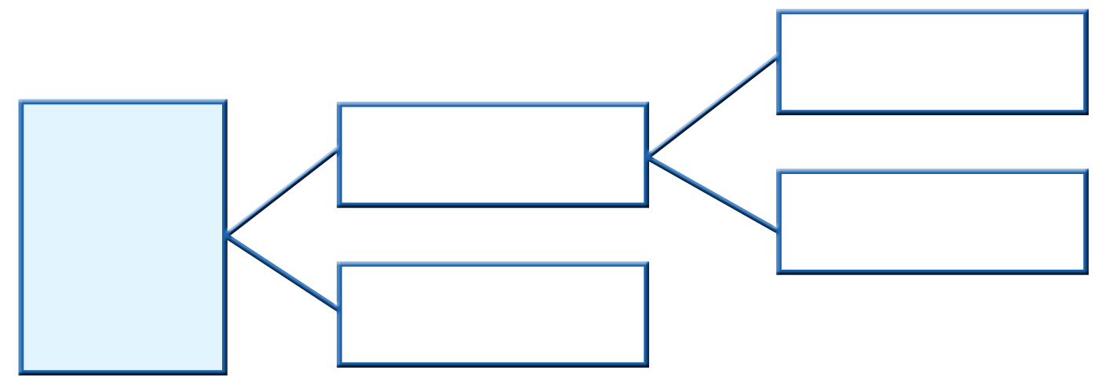
Federal Reserve System
Economics and the Global Economy
Chapter
2
Interest Rates
The Federal Reserve System is the Central Bank of the United States
Guides Monetary Policy
Foreign Exchange Rates
Regulates the U.S. Banking System

Slide 14
Federal Reserve System
Economics and the Global Economy
Chapter
2
Functions
Regulate the Money Supply
Foreign Exchange Markets
Influences the economy through control over the federal funds rate
May lower interest rates in a recession
May raise interest rates when the economy is growing too fast
Changes in monetary policies affect international relations and trade
A weak dollar and a strong dollar affect the economy in different ways

Slide 15
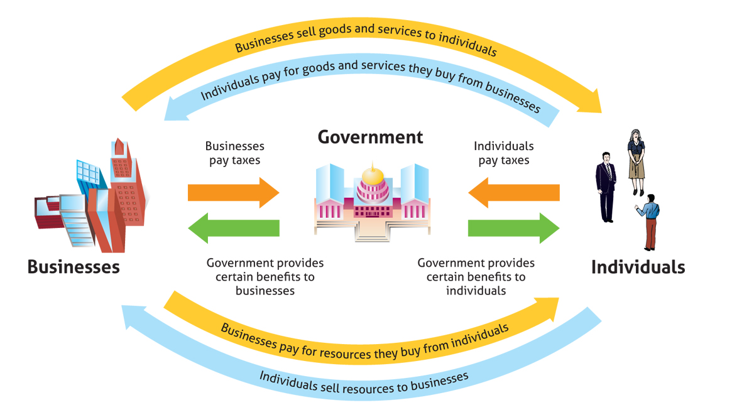
Business Cycles
Economics and the Global Economy
Chapter
2
Section 2

Slide 16
Economic Indicators
Economics and the Global Economy
Chapter
2
Section 2
Gross Domestic Product (GDP)
Consumer Price Index (CPI)
Inflation – when prices go up
Deflation – when prices go down
Unemployment Rate

Slide 17
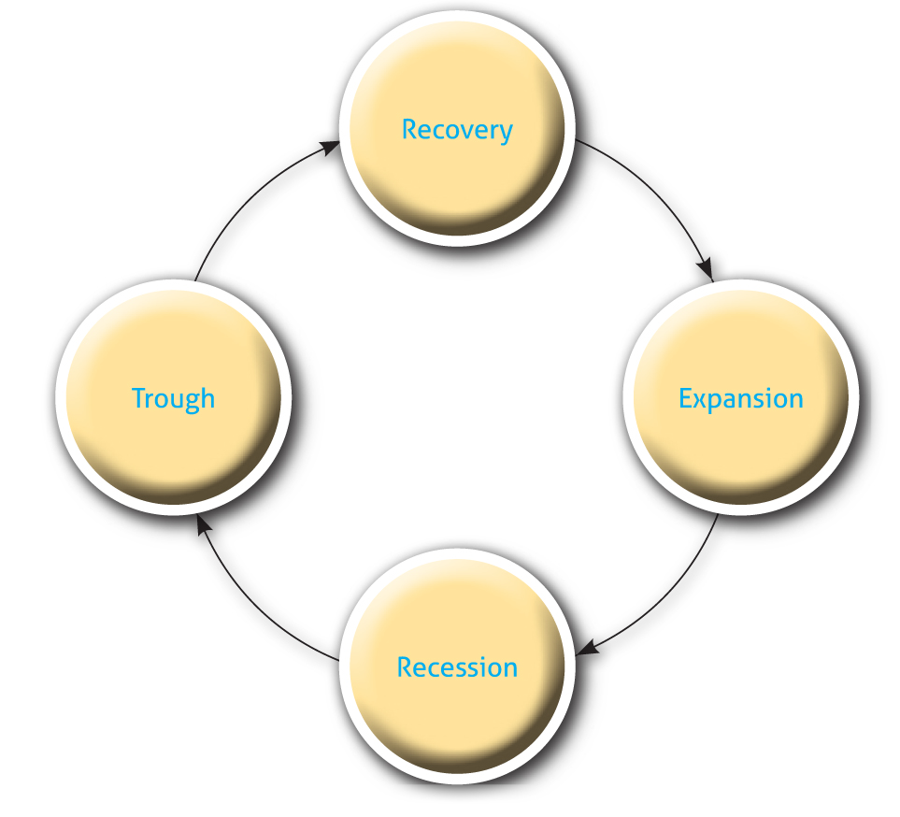
Economics and the Global Economy
Chapter
2
The Flow of the Segments of the Business Cycle

Slide 18
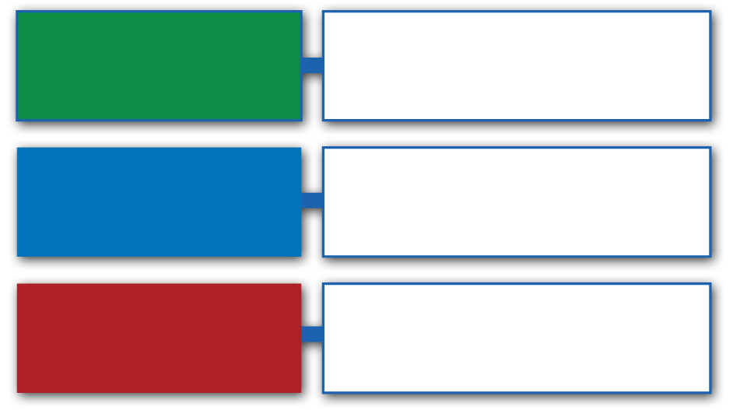
Roles of Trade
Economics and the Global Economy
Chapter
2
Section 2
Individuals
Trade skills for wages
Trade goods and services for revenue
Organizations
Trade with other nations for resources
Nations

Slide 19
Roles of Trade
Economics and the Global Economy
Chapter
2
Section 2

