Slide 1
Business Math
Chapter 6
Sources of Funding

Slide 2
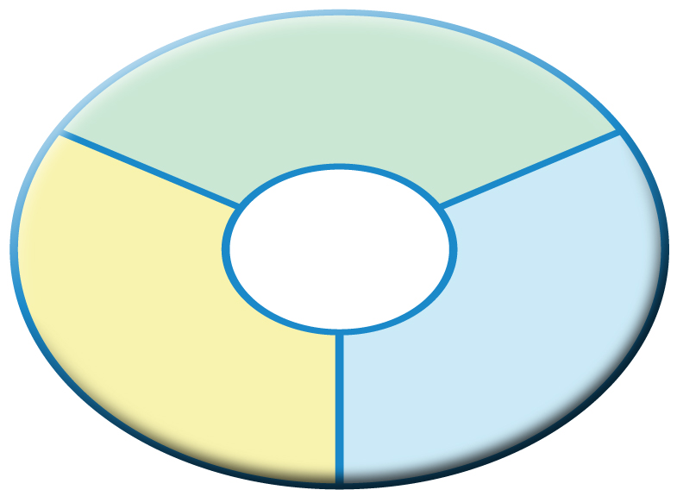
Determining Required Capital
Developing a Financial Plan
Chapter
5
Start-Up Capital
Three Types
of Required Capital
Operating Capital
Reserve
Capital

Slide 3
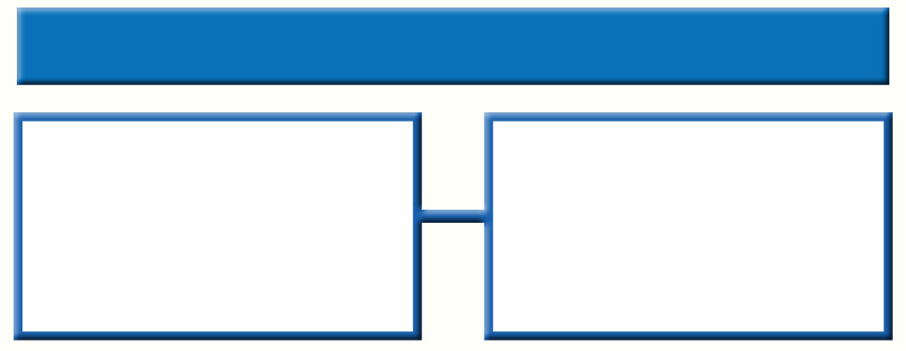
Business Entrepreneurs
Sources of Funding
Chapter
6
Entrepreneurs Are Highly Motivated People
About 80 percent of the 23 million business operations in the United States are run by the owner.
Seven out of every ten high school students have said they would like to start a business

Slide 4

Starting a New Business
Sources of Funding
Chapter
6
What Do You Need to Start a New Business?
Goods or
Services
to Sell
Cash
Equipment
Supplies

Slide 5

Determining Needed Capital
Sources of Funding
Chapter
6
Common Start-Up Costs
Inventory
Equipment, fixtures, display cases
Security deposits
Advertising and promotions
Insurance
Professional fees
Remodeling costs
Legal permits and licenses
Supplies

Slide 6
Funding a Business
Sources of Funding
Chapter
6
Funding
People who take on a business venture usually need far more money than they realize.
Banks and other financial institutions are very selective about who receives loans.

Slide 7
Personal and Private Funding
Sources of Funding
Chapter
6
Personal Savings
Consumer Loans
Home Equity Loans
Personal Loan

Slide 8
Bank Funding
Sources of Funding
Chapter
6
Section 1
Advantages of a Small Bank
Experience dealing with small businesses
Wide variety of loan plans
Advice and other business services
Community-oriented
Disadvantages of a Small Bank
Closely regulated by the government
Extensive paperwork, investigation, and documentation for the loan process
Conservative by nature and may refuse loans for businesses that appear risky

Slide 9
Bank Funding
Sources of Funding
Chapter
6
Section 1
Long-Term
Loans
One to five years
Short-Term
Loans
Typical for large businesses
Useful for very large purchases
30-, 60, or 90-day periods
Typical for small businesses
Useful for purchasing merchandise

Slide 10
Bank Funding
Sources of Funding
Chapter
6
Section 1
Secured
Loan
Backed by collateral
Unsecured
Loans
Typical for most businesses
No collateral
Only for well established businesses
Usually short term and higher interest rates

Slide 11
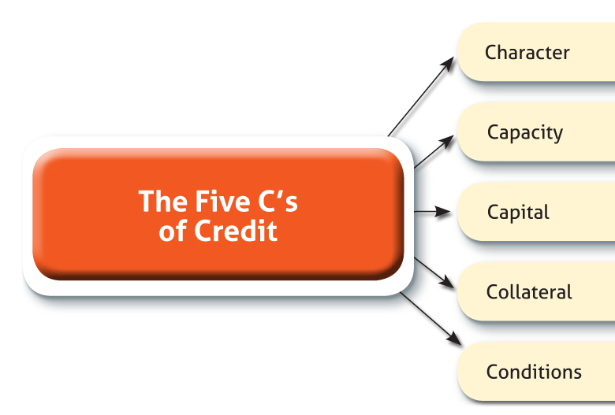
Commercial Loan Applications
Sources of Funding
Chapter
6

Slide 12
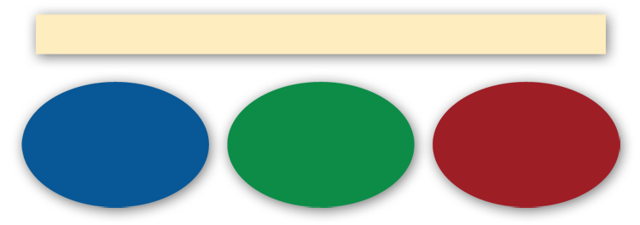
Commercial Loan Applications
Sources of Funding
Chapter
6
Banks Want to See a Business Plan That Is
Well Planned
Clear
Accurate

Slide 13


State and Local Funding
Sources of Funding
Chapter
6
More likely to support small business
Encourages the creation of new businesses and jobs
State and local funding is not focused on profit

Slide 14
Funding Your Dreams
Sources of Funding
Chapter
6
Why are small business essential?
The American economy was built by entrepreneurs.
Entrepreneurs recognize consumer wants.
Entrepreneurs recognize opportunity.
Entrepreneurs provide jobs.
Entrepreneurs create a market for venture capital.
Almost all of the nation’s Fortune 500 companies started as small businesses.
Individuals
Organizations

Slide 15
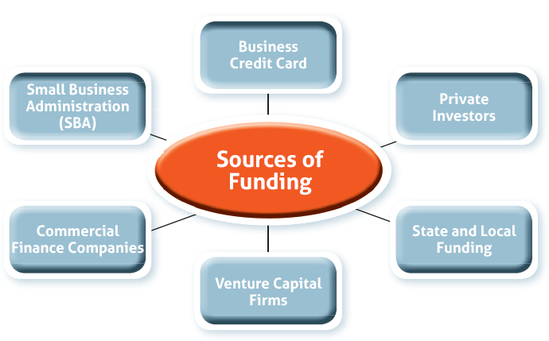
Sources of Funding
Sources of Funding
Chapter
6
Individuals
Organizations

Slide 16

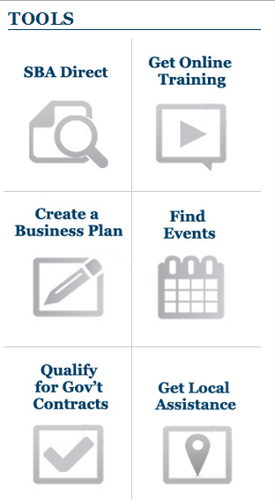
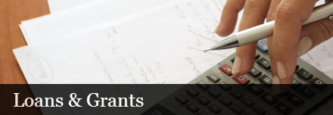
The Small Business Administration
Sources of Funding
Chapter
6

Slide 17
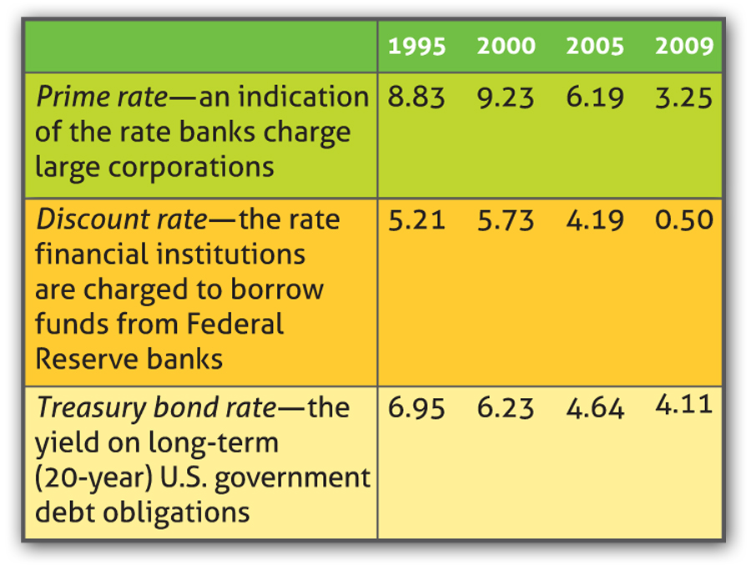
Sources of Funding
Chapter
6
Interest Rates and Risk
If a loan is
risky, the interest rate is higher.

Slide 18
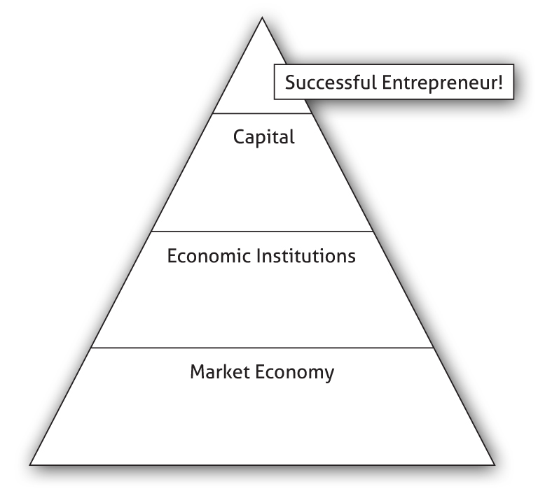
Sources of Funding
Chapter
6

