Slide 1
Chapter 12
Budgeting

Slide 2
Money Management Strategy
Chapter
12
money management
safe-deposit box
personal financial statement
net worth
assets
wealth
liquid assets
real estate
market value
liabilities
insolvency
cash flow
income
take-home pay
discretionary income
surplus
deficit
budget
budget variance

Slide 3
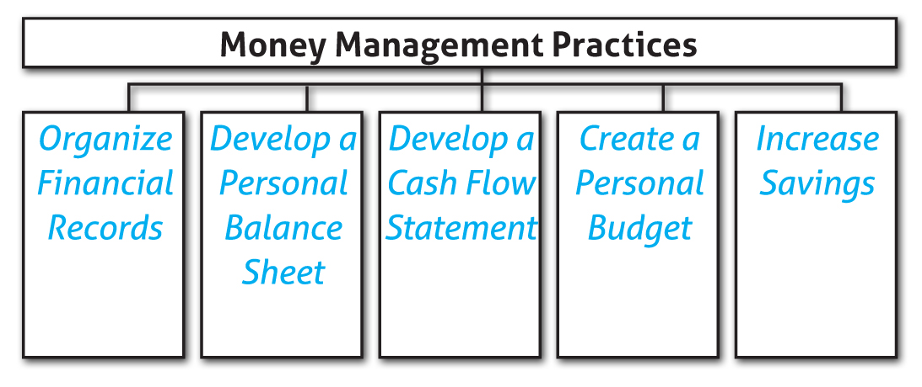
Money Management Strategy
Chapter
12

Slide 4
Organization of Financial Documents
Money Management Strategy
Chapter
12
Financial Documents
Automobile Titles
Pay Stubs
Bank Statements
Birth Certificates
Marriage License
Broker Reports
Credit Card Statements
Tax Forms

Slide 5
Organization of Financial Documents
Money Management Strategy
Chapter
12
What can an organized system do for you?
Determine your current financial status.
Pay your bills on time.
Complete required tax reports.
Plan for the future.
Make sound financial decisions related to investments.

Slide 6
Money Management Strategy
Chapter
12
Section 1
Organizing Financial Records
How are the roles of maintaining financial records and managing opportunity costs in a sound financial plan similar and different?
Managing opportunity costs and maintaining financial records are both critical to a sound financial plan. Making sound financial decisions to get the most out of your money is an important step. In order to make and track these decisions you need to maintain financial records to keep track of your money and determine your financial position.

Slide 7
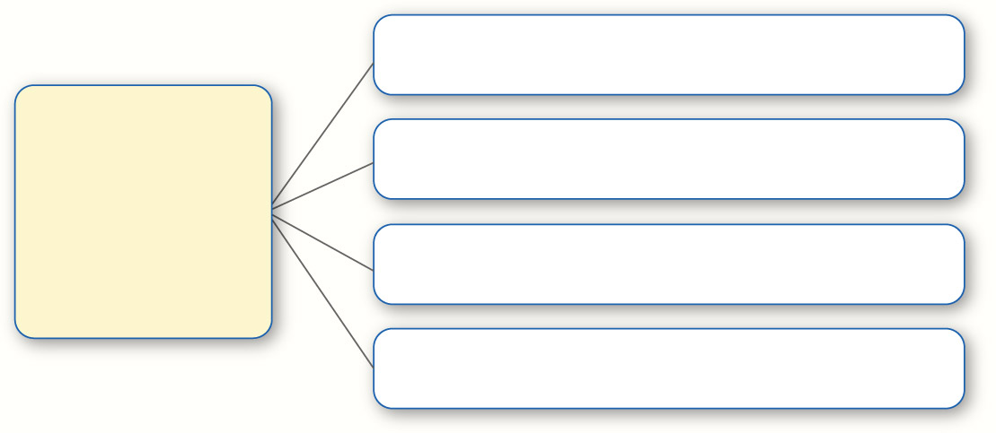
Personal Balance Sheet
Money Management Strategy
Chapter
12
Reduce Expenses
How to Increase Your Net Worth
Reduce Spending and Debts
Increase Your Savings
Increase Your Investments

Slide 8
Money Management Strategy
Chapter
12
Section 2
Personal Financial Statements
How are a personal balance sheet and cash flow statement similar? How are they different? What role does each play in the development of a personal financial plan?
A cash flow statement and a personal balance sheet both list expenses/liabilities and provide a snapshot of your financial situation. However, a cash flow statement does not break down all of your liabilities. It focuses on your monthly payments. A personal balance sheet does not show your income only the balance in your accounts.

Slide 9
Preparing a Budget
Money Management Strategy
Chapter
12
Section 3
Steps to Developing a Budget
7. Review Spending and Saving Patterns
6. Record What You Spend
5. Budget for Variable Expenses
4. Budget for Fixed Expenses
3. Budget for Unexpected Expenses
2. Estimate Your Income
1. Set Your Financial Goals

Slide 10
A Successful Budget
Money Management Strategy
Chapter
12
Characteristics of an Effective Budget
Carefully Planned
Flexible
Easily Accessible
Practical

Slide 11
Increasing Your Savings
Money Management Strategy
Chapter
12
Savings Strategies
Pay Yourself First
Use Payroll Savings
Spend Less

Slide 12
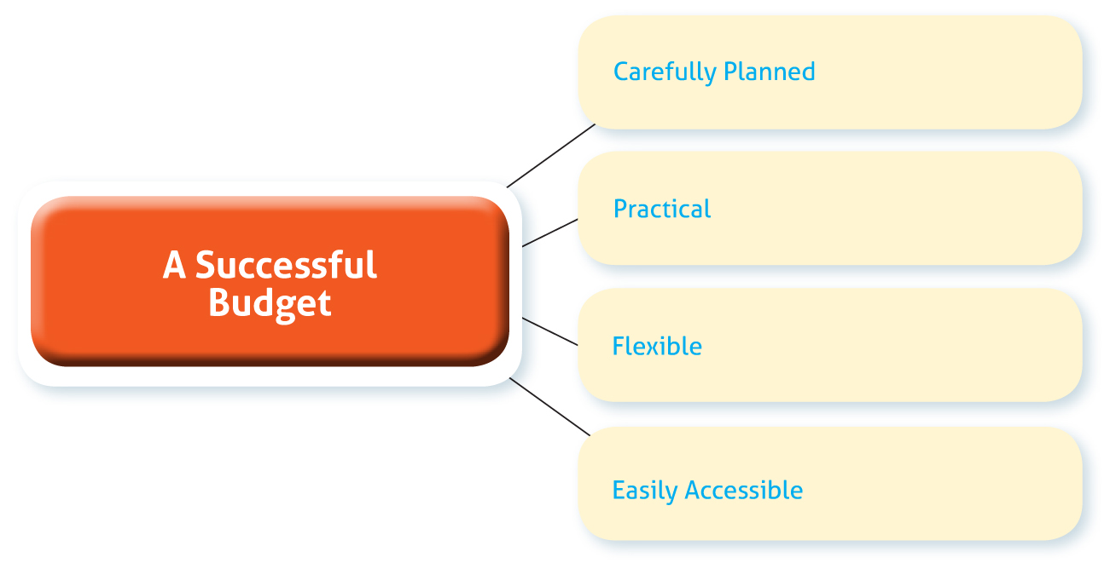
Money Management Strategy
Chapter
12

