Slide 1
Tax Unit: Module 7
East Jackson High School
Consumer Math Class

Slide 2
Module 7: Standard Deduction
Introduction
The standard deduction reduces the income subject to tax.
The amount of the standard deduction depends on these factors:
filing status
the age of the taxpayer and spouse
whether the taxpayer or spouse is blind
whether the taxpayer can be claimed as a dependent on another taxpayer’s return

Slide 3
Standard Deductions for 2015
Single $6,300
Head of household $9,250
Married filing a joint return $12,600
Qualifying widow(er) with dependent child $12,600
Married filing a separate return $6,300
Tax Tip: Some taxpayers will itemize deductions. When their itemized deductions are greater than the standard deduction, they use the itemized deductions instead of the standard deduction.

Slide 4
Sample Tax and Credits Section of Tax Return Form
Review the tax and credits section of the tax return for Brian and Sylvia Lyons. Brian and Sylvia are married and file a joint return. They have three dependent children.
The adjusted gross income is $63,825.
The standard deduction is $12,600 (based on 2015).
There are five exemptions. The exemption amount is $4,000 (based on 2015). The total deduction for exemptions is $20,000 ($4,000 X 5).
$63,825 - $12,600 - $20,000 = $31,225
Taxable income is $31,225

Slide 5
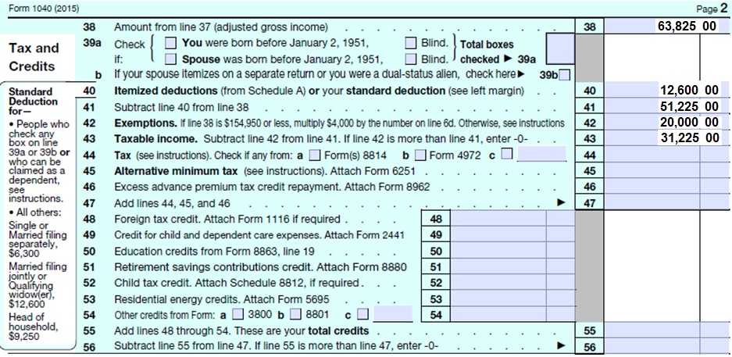
Lyons Tax and Credit Section

Slide 6
Other Standard Deduction Factors
The standard deduction is increased for taxpayers and spouses who are
age 65 or older, or
blind,
The standard deduction may be reduced for a taxpayer who can be claimed as a dependent on another taxpayer’s return.
For 2015, the standard deduction for a taxpayer who can be claimed as a dependent on another taxpayer’s return was
earned income (wages, salaries, tips, etc.) plus $350
but not less than $1050
and not more than the standard deduction for the single filing status.($6300)

Slide 7
Quick Check!
1. The standard deduction
a. increases the income that is subject to tax.
b. decreases the income that is subject to tax.
c. increases the number of exemptions.
d. increases the number of exemptions.
2. Which of the following is true?
a. The standard deduction determines the number of dependents.
b. The standard deduction depends on the filing status.
c. The standard deduction affects the amount of wage income.
d. The standard deduction is the same for all U.S. citizens and residents.
3. Which statement is true?
a. The standard deduction for a taxpayer who can be claimed as a
dependent on another taxpayer’s return is more than the standard
deduction for the single filing status.
b. The standard deduction is reduced for taxpayers who are blind.
c. The standard deduction is not affected by the age of the taxpayer or
spouse.
d. The standard deduction reduces the income that is subject to tax.

Slide 8
Review!
The number of exemptions determines the standard deduction amount.
a. True
b. False
The standard deduction amount is increased for taxpayers who are blind.
a. True
b. False
The standard deduction reduces the income that is subject to tax.
a. True
b. False
The standard deduction for taxpayers who can be claimed as dependents on another taxpayer’s return is zero.
a. True
b. False

Slide 9
Simulation A for Module 7: Filing 1040 EZ for Monica
You are Monica L. Lindo
You are a full-time student, part-time registration assistant in an ER
You are single with no children
You are a U.S. citizen
You are 20 years old and live with your parents, who pay for all other costs of maintaining the home. Your parents paid for your food, clothing, and tuition during this tax year. You paid for your books and transportation.
SS# 222-00-5463

Slide 10
Simulation A for Module 7: Filing 1040 EZ for Monica
If you receive a refund, you will want it to be directly deposited to your checking account.
Routing #: 242222111
Account #: 10230222332
On line 10, use the tax tables on the IRS web site
Link: http://www.irs.gov/pub/irs-pdf/i1040tt.pdf

Slide 11
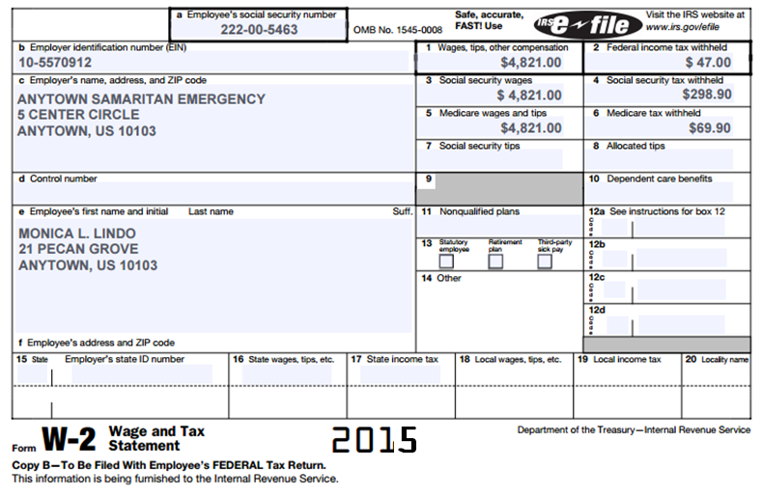
Monica’s W-2

Slide 12
Congratulations!
You have just successfully completed Module 7!!!

Slide 13
All information came from the Internal Revenue Service Understanding Taxes Program
www.irs.gov/app/understandingTaxes/jsp/S_student_lessons.jsp

