Slide 1
Tax Unit: Module 2
Consumer Math Class
East Jackson High School

Slide 2
Module 2: Wage and Tip Income
Introduction
All income from
wages
salaries and
tips
is taxable.

Slide 3
Wages, Salaries, and Tips
Wages, salaries, bonuses, and commissions are compensation received by employees for services performed.
Tips are received as gratuities by food servers, baggage handlers, hairdressers, and others for services performed. Tips go beyond the stated amount of the bill and are given voluntarily.
Employee compensation and tips may be in the form of cash, goods and services, awards, and taxable benefits.
Tax Tip: Self-employed individuals are not employees. Self employment income is taxable, but it is not included with wage and tip income on the tax return.

Slide 4
What is taxable?
Unless specifically excluded, all wages, salaries, commissions, and bonuses are taxable
All tip income is taxable and needs to be reported

Slide 5
Quick Check!
___1. Wages earned by a worker at a casual fast-food restaurant
a. Taxable
b. Nontaxable
___2. Tips earned by a server in a fashionable restaurant
a. Taxable
b. Nontaxable
___3. Overtime pay earned by a construction worker for working extra hours to complete a project on time
a. Taxable
b. Nontaxable
___4. Bonus given to a salesperson for making the most sales during the month
a. Taxable
b. Nontaxable
___5. Free lawn care service for a month for a mailroom employee who developed a handbook for new employees
a. Taxable
b. Nontaxable

Slide 6
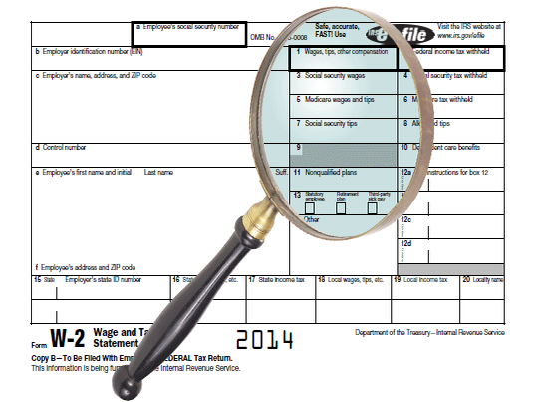
Form W-2
Wages, salaries, and tip income are reported on Form W-2, Wage and Tax Statement.
Employers provide Form W-2 to the employee and to the federal government.
Employees use Form W-2 to complete their tax returns
Tax Tip: All wages, salaries, and tip income are taxable even if they are not reported on Form W-2.

Slide 7
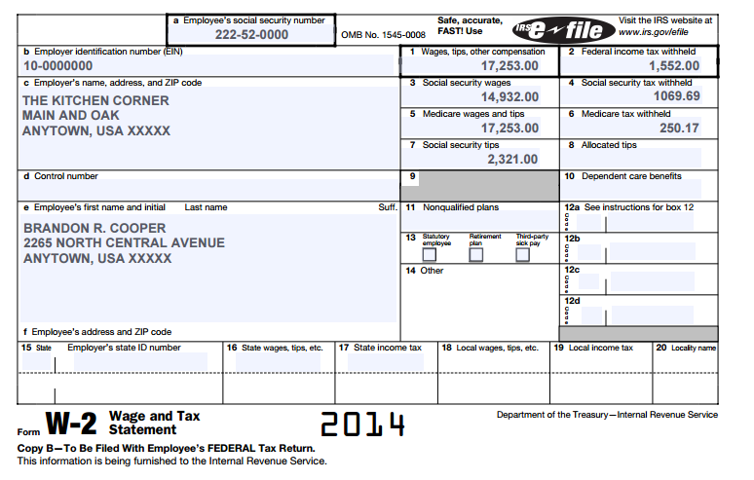
Quick Check!
$17,253
1) What is the amount of wages, tips, and other compensation? ________
2) How much federal income tax was withheld? ___________
3) Who is the employee? ______________________
4) Who is the employer?________________________
5) What is reported in box 4?
a. Medicare tax withheld
b. Federal income tax withheld
c. Advance EIC payment
d. Social Security tax withheld
6) What is reported in box 6?
a. Medicare tax withheld
b. Federal income tax withheld
c. Advance EIC payment
d. Social Security tax withheld
$1,552
Brandon R. Cooper
The Kitchen Corner

Slide 8
Review!
____1. Food servers do not need to report tips as taxable income.
a. True
b. False
____2. Hairdressers include in taxable income the tips they receive from customers.
a. True
b. False
____3. Employers use Form W-4 to report wage and tax information to employees.
a. True
b. False
____4. Tips can be received in the form of money or goods.
a. True
b. False

Slide 9
Using a W-2 to File Your Taxes on a 1040EZ
1040EZ is a tax return form for single and joint filers with no dependents
You will use it to figure out the taxes you have already paid and the taxes you owed the government for the year.
If what you have paid is more than what you owed, you will get a refund of the difference.
If what you have paid is less than what you owed, the difference is the amount you owe the government.

Slide 10
Simulation for Module 2 Learn how to fill out a 1040EZ from a W-2
Your name is Cicely B. King
You are a coach at Any Town High School
You are single
You have no children
You are a U.S. Citizen
Use the following W-2 to fill out the 1040EZ
On line 10 enter $2,273
(Normally you would use the IRS website to look this up)

Slide 11
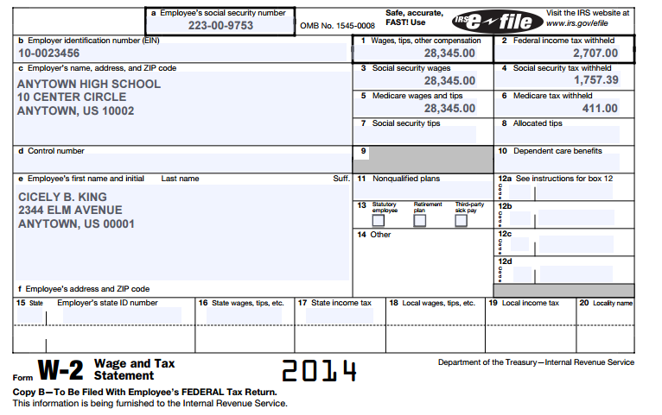
Cicely’s W-2

Slide 12
Click Here For
Cicely’s 1040EZ

Slide 13
Congratulations!
You have just successfully completed Module 2!
All information came from the Internal Revenue Service Understanding Taxes Program
www.irs.gov/app/understandingTaxes/jsp/S_student_lessons.jsp

