Slide 1
Tax Unit: Module 13
Consumer Math Class
East Jackson High School

Slide 2
Module 13: Electronic Tax Return Preparation and Transmission
Introduction
Tax preparation is the completion of the forms and schedules needed to compute and report the tax.
Tax transmission refers to sending the return to the taxing authority.

Slide 3
Preparation of a Tax Return
Complete all of the forms and schedules needed to compute and report the tax.
Preparation can be
Manual, using paper and pencil, or
Electronic

Slide 4
Benefits of Electronic Preparation
Increased accuracy
Ease of use
Ability to prepare federal and state returns at the same time

Slide 5
Transmission of a Tax Return
Send the tax return to the taxing authority.
Transmission can be
through the mail
through electronic filing (e-file) options:
Online, self-prepared; or
Authorized IRS e-file Provider/Tax Professional.

Slide 6
Benefits of Electronic Transmission
Accuracy
Secure
Paperless with the self-select PIN option
Electronic acknowledgement
Direct deposit for faster refunds
Free/low-cost filing
Electronic funds withdrawal for payments
Able to transmit federal and state taxes at same time

Slide 7
Electronic – Online, Self-prepared Option
Use a personal computer to prepare and transmit tax returns.
Expert systems (often called wizards) guide taxpayers through the process.
Requires a computer with a modem and/or Internet access.
Alternative 1: Prepare return on personal computer, sign return with self-selected PIN, and transmit over the Internet. (Taxpayer purchases software.)
Alternative 2: Prepare return online, sign return with self-selected PIN, and transmit over the Internet. (Taxpayer does not purchase the software.)
A taxpayer prepares and transmits from:
home
workplace, an employer-provided benefit
library, usually free
financial institution, usually free
business, usually for a fee

Slide 8
Electronic – Electronic Return Originator Option
Electronic Return Originators (EROs) are authorized to transmit returns to the IRS.
Often EROs also prepare returns.
Many EROs charge a fee.
EROs include some:
Certified public accountants (CPAs)
Tax attorneys
IRS enrolled agents (individuals who are registered with the IRS)
Tax preparation businesses
VITA (Volunteer Income Tax Assistance) sites
Walk-in sites

Slide 9
Security
Personal Identification Numbers (PINs) ensure that the taxpayer, and not someone else, transmitted each return.
A PIN allows the taxpayer to “sign” the return electronically.
Most taxpayers can qualify to use a PIN by providing their
date of birth, and
adjusted gross income from their originally filed prior year tax return (not from an amended return [Form 1040X]).

Slide 10
IRS Web Site
Review the IRS Web site [http://www.irs.gov] for
free/low-cost online filing options under IRS e-file partners offering their services to qualified taxpayers.
software companies in the online e-file program.

Slide 11
Some Online Providers

Slide 12
Quick Check!
Taxpayers can prepare returns online at
a. Financial institutions
b. Work
c. Library
d. All of the above
What information is needed to self-select a personal identification number (PIN)?
a. Date the tax return was filed in the prior year
b. Taxpayer’s date of birth
c. Wage income from the prior year return
d. Tax credits claimed in the prior year return
Which of the following is an example of an Electronic Return Originator (ERO)?
a. Certified Network Administrator
b. Tax attorney
c. Human resource specialist
d. Volunteer Meals-on-Wheels Coordinator
Which of the following are benefits of electronic tax preparation and transmission?
a. The reduction of errors
b. Ease of use
c. Security
d. All of the above

Slide 13
Review!
1. Tax preparation is sending the return to the taxing authorities.
a. True
b. False
2. Tax returns can be prepared electronically, but they must be mailed to the IRS.
a. True
b. False
3. A Personal Identification Number is used to authenticate an electronically transmitted tax return.
a. True
b. False
4. A taxpayer who prepares his or her own tax return is considered an Electronic Return Originator (ERO).
a. True
b. False

Slide 14
Tax Simulation 7
You are Madison Mailey
You are a caterer
You are single with one child, Robyn, age 7 (SS# 222-00-2222)
You are both U.S. Citizens
You will use the Head of Household Filing Status
You provided all of the support for Robyn
You will have $473 credit for child and dependent care expenses. (Line 49)
You have a Child Tax Credit of $1000 (Line 52)
For line 44, use the tax table on the IRS website
Any refund you would like direct deposited into your checking account: Routing # 987654321 and Account # 987987987987

Slide 15
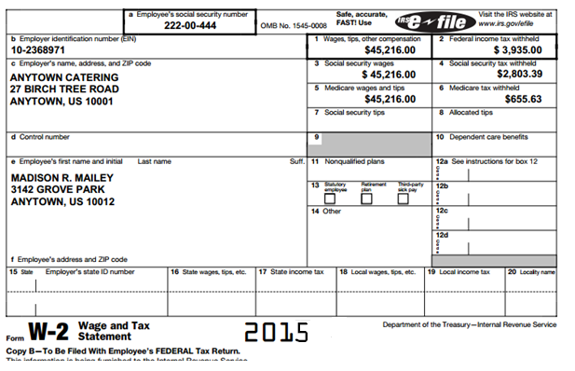
Madison’s W-2

Slide 16
Congratulations!
You have successfully completed Module 13!!
All information came from the Internal Revenue Service Understanding Taxes Program
www.irs.gov/app/understandingTaxes/jsp/S_student_lessons.jsp
http://turbotax.intuit.com/tax-tools/tax-tips/General-Tax-Tips/Video--How-TurboTax-Guides-You-Step-by-Step-Like-a-GPS/INF14582.html

